Slide 1
Paediatric pneumonias
DR. PATIL

Slide 2
OUTLINE
Introduction
Classification of pneumonia
Viral Pneumonia and radiographic patterns

Slide 3
Pneumonia
Consolidation of the lungs produced by inflammatory exudate, usually as a result of an infectious agent
Produce airspace disease – lobar/segmental
Others demonstrate interstitial disease
Spread to the lungs through the tracheobronchial tree- inhalation or aspiration of organisms
Bloodstream
Direct extension

Slide 4
Risk factors
Neonates: PROM, Prolonged/complicated labour, prematurity
Immunodeficiency: HIV, PEM
Congenital heart disease
Congenital resp. malformations e.g TEF, GER
Defective clearance of airway secretions e.g cystic fibrosis
Chronic pulmonary diseases e.g TB, bronchiectasis, Asthma
Travel to certain regions

Slide 5
Clinical features
Poor feeding, Irritability
Fever
Cough
Respiratory distress
Wheezing
Cyanosis
Chest pain, headaches, vague abdominal pain
Vomiting, Diarrhoea

Slide 6
Clinical classification
Hospital acquired eg staph aureus
Community acquired e.g
  Strep pneumonia
  H. influenzae
  Staph aureus
  Mycoplasma

Slide 7
Classification by etiology
Bacterial
  Strep pneumonia
  Hemophilus influenza
Viral
  Influenza
  RSV
  Adenovirus
Notes:
Etiology changes with age

Slide 8
Classification by patient status
Primary pneumonia (in previously healthy patients)
Secondary pneumonia (in persons with an underlying abnormality eg. Pulmonary sequestration, cardiac disorders, immune deficiency, tracheo-esophageal fistula)
Notes:
Pulmonary sequestration= Aberrant lung tissue develops without any connection to the bronchial tree or pulmonary artery.

Slide 9
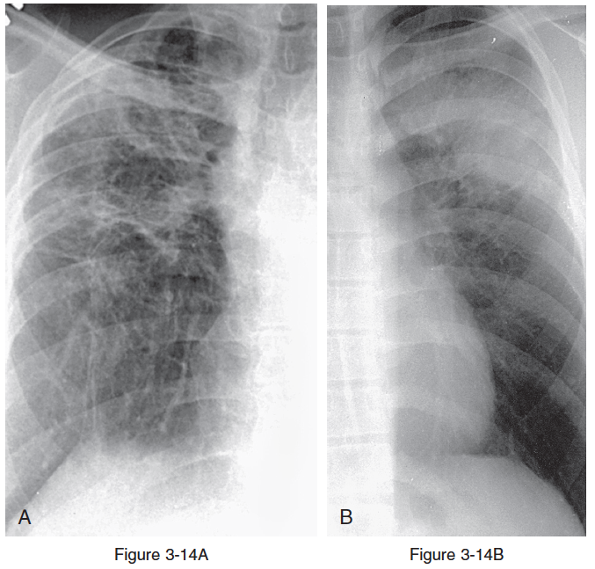
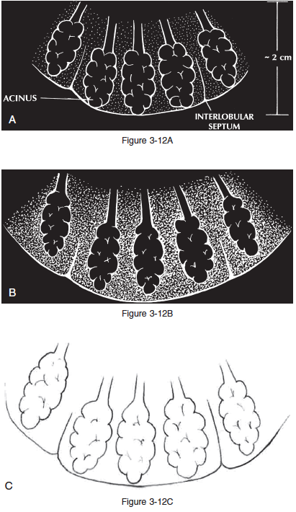
Classification by radiological pattern
Airspace/Alveolar pneumonia- e.g lobar, segmental, bronchopneumonia or round pneumonia
Intersitital pneumonia- Affecting the structures supporting the alveoli eg vessels, lymphatics, bronchi and connective tissue
Notes:
A- Interstitial lung disease
B- Airspace (Alveolar) disease

Slide 10
Indications of chest imaging
In an infant or toddler with fever and any of the following:
Tachypnea
Nasal flaring
Retractions
Grunting
Rales
Reduced breath sounds
Respiratory distress

Slide 11
Indications of chest imaging
Trauma
Foreign body inhalation
Poor response to treatment
Recurrent chest infections
Suspected cardiac and lung abnormalities
Pulmonary TB exposure
Staging of metastasis

Slide 12
Patterns of pneumonia
Lobar
Segmental
Interstitial
Round
Cavitary

Slide 13
Viral Pneumonia
Immunocompetent
RSV (also immunocompromised)
HPIV
Influenza
HMPV
Adenovirus (also immunocompromised)
Rhinovirus
Immunocompromised
CMV
EBV
HSV
VZV

Slide 14
Pathophysiology: Viral Pneumonia
Usually affects the resp mucosa and airways
Inflammation and necrosis > peribronchial edema
Also causes occlusion of smaller airways
Atelectasis
Hyperinflation

Slide 15
Radiological patterns: Viral Pneumonia
Parahilar peribronchial infiltrates
Patchy areas of consolidation
Hyperexpansion (hyperinflation)
Segmental or lobar atelectasis
Hilar adenopathy
Interstitial lung disease

Slide 16
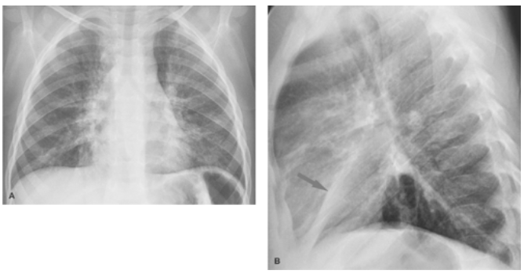
https://www.ncbi.nlm.nih.gov/pmc/articles/PMC3474028/
Notes:
Atelectasis with a viral infection:
Bilateral ill-defined perihilar, peribronchial opacities are the result of a viral bronchitis, accompanied by focal streaky opacity in the right lower lobe
Lateral view shows the linear nature of the right middle lobe opacity, consistent with atelectasis (arrow)

Slide 17
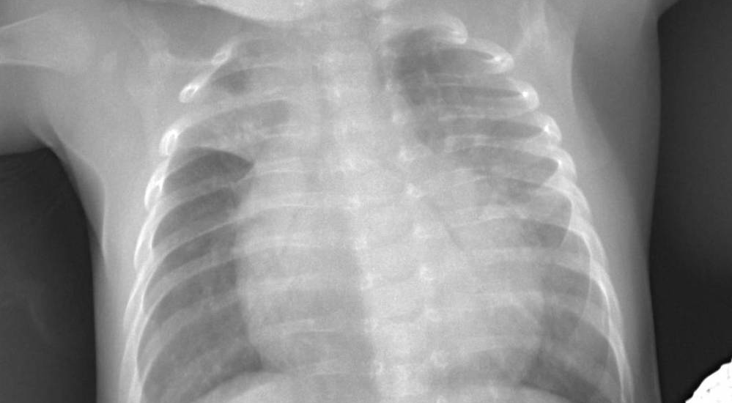
https://www.ncbi.nlm.nih.gov/pmc/articles/PMC3474028/
Notes:
RSV pneumonia
Right upper lobe (RUL) consolidation with air bronchogram. Horizontal fissure concave towards RUL as sign of partial RUL atelectasis, most probably due to occluded bronchus.
Alveolar/interstitial-alveolar infiltrates with air bronchograms throughout left lung, more pronounced in the upper zone.

Slide 18
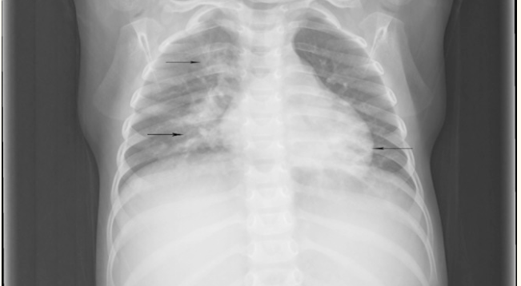
https://www.ncbi.nlm.nih.gov/pmc/articles/PMC3474028/
Notes:
An example of bilateral patchy areas of consolidation in the lower lung zones and the right upper zone (arrows) a chest radiograph taken 5 days after the onset of symptoms in a 4-year-old male with influenza A. ap, anteroposterior; R, right

Slide 19
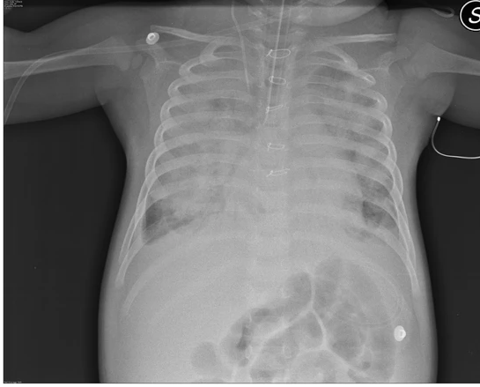
Varicella Zoster Pneumonia
Notes:
2 year old unvaccinated italian caucasian female affected by down’s syndrome and surgically corrected intra-ventricular defect at 3 months of age, with a history of 2 episodes of pneumonia was admitted in the ER for in cardiac arrest with an ongoing varicella infection
CXR-Multiple bilateral widespread foci of airspace consolidation with bilateral pleural effusion.Deteriorated to ARDS and later succumbed due to a pulmonary haemorrhage

Slide 20
References
Felson’s principles of chest Roentgenology pages 50-65
Donelly L F, Fundamentals of Pediatric Imaging page 79-98
radiologykey.com/pediatric-chest
https://emedicine.medscape.com/article/1926980-overview#a1
https://www.ncbi.nlm.nih.gov/pmc/articles/PMC3474028/
Radiopaedia
DIRM previous presentations

